Slide 1
IS4432 Systems Design
Week 4 – Design Strategies
Adapted by Janet Yu

Slide 2
Agenda
Understand the 3 types of design strategies
Understand how to select a design strategy
Guest Talk
  How to Choose Service Providers
Individual Assignment
  Keep the answer in one page
  Submit to blackboard within the same day

Slide 3

If you want to give your sister a sweater as birthday gift, will you:
  Knit it yourself?
  Purchase one from retail shop?
  Ask your mother for help?
Why? Give me two reasons.

Slide 4

Alternative ways of creating the new system?
Custom Development
Packages Software Outsourcing

Slide 5
Custom Development
Build a system in-house with the company’s own developers
Advantages:
  Have complete control over system functionality
  Allows for meeting highly specialized requirements
  Allows flexibility and creativity in solving problems
  Easier to change components in the future

Slide 6
Custom Development
Disadvantages:
  May have backlogs of systems requests because developers are already working overloaded
  Keeping developers can be costly
  Developers may be pulled away to work on other projects
  Developers may not have sufficient technical expertise

Slide 7
Packaged Software
Software already written
Many business needs are not unique
Advantages:
  Relatively inexpensive
  May be more efficient (brought and installed in a relatively short period of time)
  May be more thoroughly tested and proven
  May range from components to tools to whole enterprise systems
  Most packaged application allow for “customization” – manipulation of system parameters eg company logo, inventory control

Slide 8
Packaged Software
Disadvantages:
  Must accept functionality provided
  May require change in how the firm does business and in turn resistance to changes
  May require “workarounds” – a custom-built add-on program to cater functionality not exist in the software package
    Workarounds are not supported by vendor and thus not compatible with software package upgrades
    Vendor tends to blame workarounds if problems arise
  May not be able to interface with existing systems and thus need to invest on system integration

Slide 9
Outsourcing
Hire external firm to create system
  Most common nowadays
Advantages:
  may have more technical expertise (the firm is lack of in-house expertise)
  may extend existing resources (especially when the firm is lack of in-house resources or internal resources are costly)

Slide 10
Outsourcing
Disadvantages:
  May disclose confidential information
  May lose control over future development
  May suffer from language barrier, time-zone differences and cultural differences if it’s offshore outsourcing

Slide 11
Outsourcing
Be cautious:
  Must fully understand needs and requirement. Never outsource what you don’t understand
  Carefully choose vendor
  Prepare contract and payment style carefully
  Someone need to be assigned full-time to manage the outsourcer

Slide 12
Selecting a Design Strategy
Business need
In-house experience
Project skills
Project management
Time frame

Slide 13
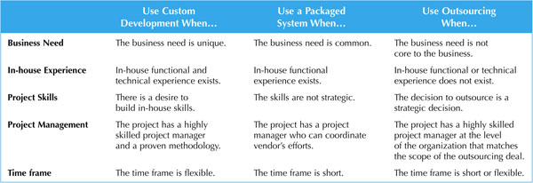
Selecting a Design Strategy

